Slide 1
Chapter 3
Internet Domain and Domain Name System

Slide 2
Domain Name
A domain name is an identification string that defines a realm of administrative autonomy, authority or control within the Internet.
Domain names are formed by the rules and procedures of the Domain Name System (DNS).
Any name registered in the DNS is a domain name

Slide 3
Domain Name System (DNS)
Domain Name System, a system for naming computers and network services that is organized into a hierarchy of domains.
DNS naming is used in TCP/IP networks, such as the Internet, to locate computers and services through user-friendly names
The Domain Name System (DNS) is a hierarchical distributed naming system for computers, services, or any resource connected to the Internet or a private network

Slide 4
How Domain Name Registration Works
You pay for your own domain name
The registrar then "holds” the domain name for you
Assign what are known as DNS numbers to the particular domain name (these DNS numbers are provided by your web host where your site stored.
If the DNS numbers are incorrect or something else doesn‘t work, your site cannot be found‐even by typing in the domain name of your site

Slide 5
Function of Domain Name System
DNS is a global database that translates domain names to Internet addresses that are used by computers to talk to each other
The Domain Name System distributes the responsibility of assigning domain names and mapping those names to IP addresses by designating authoritative name servers for each domain
It defines the DNS protocol, a detailed specification of the data structures and data communication exchanges used in DNS, as part of the Internet Protocol Suite.

Slide 6
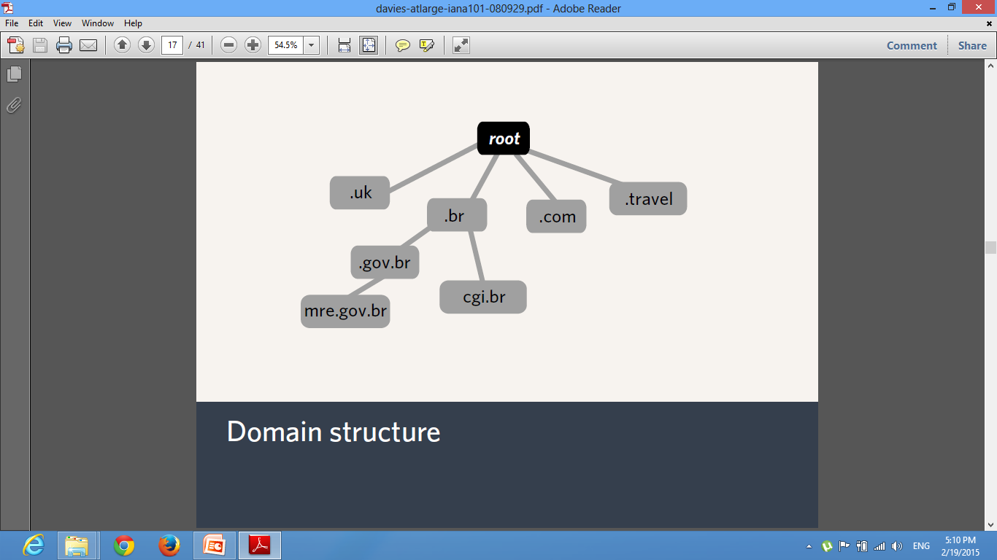
Domain Name Structure

Slide 7
Domain Names — The Root Zone
Delegates top-level domains
Root Zone Database is like a regular domain registry, albeit with different policy
Top-Level Domain Operators maintain their registration records with IANA
gTLD (Generic top-level domain) Delegations governed by ICANN contracts
ccTLD (Country code top-level domain) Delegations governed by Local Internet Community principles

Slide 8
How IANA manage the root zone
Maintain data for the DNS root
Technical data (NS records, “glue”)
Social data (admin and tech contacts, sponsoring organizations, WHOIS, Registration URLs)
Two types of changes
Routine (easy)
Confirm authenticity, check for technical problems, implement
Redelegations (hard)
Perform evaluation, submit to ICANN board, implement as appropriate.

Slide 9
What IANA don’t do for Domain
‣ Don’t set policy
IANA follow precedent where possible, encourage review of our operations by the community.
Don’t decide what the two letter codes should be
ISO 3166-1 standard provides these
Don’t decide who runs a ccTLD
The local Internet community decides this.
IANA performs due diligence to ensure requests accord with LIC view

Slide 10
What is a URL?
URL stands for Uniform Resource Locator and refers to the entire address used to visit a website, including all those colons and slashes.
This address includes the domain name
This contains the 'hypertext transfer protocol’ (http), telling the browser that you are using a domain name instead of an IP Address. This is followed by the domain name itself . This points to the server where the website is hosted and the particular files on that server to be accessed.

Slide 11
What are top level and second level domain names?
Dot Com (.com) was the first domain type to be introduced and is considered a top level domain or TLD.
Top level domains include any that contain only one suffix — for example; .net, .info, .biz and so on.
Second level domains or 2LDs are domain names containing another level after the .com or .co suffix. For example; .com.au is a second level domain style as it contains an additional suffix after the .com that shows the website originates in Australia.

Slide 12
How do domain names work?
Registering a domain name does not automatically activate a website that displays when visitors enter your domain name into a Web browser.
The domain name must have a hosted website that includes a numeric address, called an IP address, for visitors to access the website using your domain name.
Your domain name and its associated IP address are stored in a common database along with every other domain and associated IP addresses that are accessible via the Internet.
When visitors enter your domain name into a Web browser, the browser request uses your domain name to find the domain name‘s associated IP address and, therefore, the website.

Slide 13
Advanced Domain Name Description
A domain name represents a physical point on the Internet — an IP address.
The Internet Corporation for Assigned Names and Numbers (ICANN) governs coordination of the links between IP addresses and domain names across the Internet. With this standardized coordination, you can find websites on the Internet by entering domain names instead of IP addresses into your Web browser

Slide 14
What is the 'www’ before my domain name
The www before your domain name is a sub domain, not part of the domain name itself. Therefore, if you set up your www CNAME record to point to your primary A record, your site will resolve both at www.abc.com and abc.com. If you can reach your website by typing in your domain without the www but cannot reach it when you type the www, then your CNAME might be set up incorrectly

Slide 15
What is a nameserver?
Nameservers are the Internet‘s equivalent to phone books.
A nameserver maintains a directory of domain names that match certain IP addresses.
The information from all the nameservers across the Internet is gathered in a entral registry.
Nameservers make it possible for visitors to access your website using a familiar domain name, instead of having to remember a series of numbers

Slide 16
What can you do with domain once it‘s been registered?
Sell it — Domain names can be a great investment. If you have registered a domain name that you are not using, maybe someone else can.
Protect your brand online — The more domain names you register, the better. Prevent others from registering a similar domain name to yours. These similar domain names can steal your customers or Confuse them.
Hold on to it — Maybe you haven‘t decided what to do with your new domain name. Don‘t worry — there‘s no rush

